Slide 1
All Pair Shortest Path Algorithms
CSE 2202: Algorithm Analysis and Design Laboratory
Most. Kaniz Fatema Isha
Md Mehrab Hossain Opi

Slide 2
Background
Previously we learned Dijkstra and Bellman Ford’s Algorithm.
They both work as a single source shortest path algorithm.
What happens if we want to find the shortest path for each nodes in the graph?

Slide 3
Background
Could we use Dijkstra’s algorithm ?
Could we use Bellman Ford’s algorithm ?

Slide 4
Floyd-Warshall Algorithm
It is specifically designed for all pair shortest path.
It can handle negative weights, but not negative weight cycles.
This algorithm works by adapting a dynamic programming approach to check every possible path via every possible node.
k
i
j

Slide 5
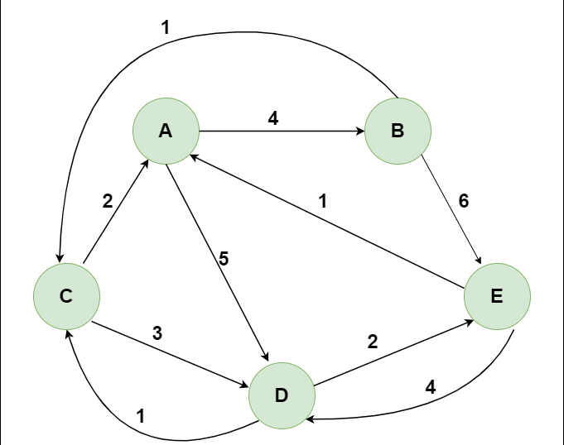
Floyd-Warshall Algorithm
Let’s see how Floyd-Warshall Algorithm works.
We will consider the following graph

Slide 6
Floyd-Warshall Algorithm
Initially we create a matrix from the given graph.
 | A | B | C | D | E
A | 0 | 4 | ∞ | 5 | ∞
B | ∞ | 0 | 1 | ∞ | 6
C | 2 | ∞ | 0 | 3 | ∞
D | ∞ | ∞ | 1 | 0 | 2
E | 1 | ∞ | ∞ | 4 | 0

Slide 7
Floyd-Warshall Algorithm
Then we start iterating over the entire matrix considering each vertex as intermediate node and calculate the distance between each pair.

Slide 8
Floyd-Warshall Algorithm
Intermediate vertex A
 | A | B | C | D | E
A | 0 | 4 | ∞ | 5 | ∞
B | ∞ | 0 | 1 | ∞ | 6
C | 2 | ∞ | 0 | 3 | ∞
D | ∞ | ∞ | 1 | 0 | 2
E | 1 | ∞ | ∞ | 4 | 0
 | A | B | C | D | E
A | 0 | 4 | ∞ | 5 | ∞
B | ∞ | 0 | 1 | ∞ | 6
C | 2 | 6 | 0 | 3 | ∞
D | ∞ | ∞ | 1 | 0 | 2
E | 1 | 5 | ∞ | 4 | 0

Slide 9
Floyd-Warshall Algorithm
Intermediate vertex B
 | A | B | C | D | E
A | 0 | 4 | ∞ | 5 | ∞
B | ∞ | 0 | 1 | ∞ | 6
C | 2 | 6 | 0 | 3 | ∞
D | ∞ | ∞ | 1 | 0 | 2
E | 1 | 5 | ∞ | 4 | 0
 | A | B | C | D | E
A | 0 | 4 | 5 | 5 | 10
B | ∞ | 0 | 1 | ∞ | 6
C | 2 | 6 | 0 | 3 | 12
D | ∞ | ∞ | 1 | 0 | 2
E | 1 | 5 | 6 | 4 | 0

Slide 10
Floyd-Warshall Algorithm
Intermediate vertex C
 | A | B | C | D | E
A | 0 | 4 | 5 | 5 | 10
B | ∞ | 0 | 1 | ∞ | 6
C | 2 | 6 | 0 | 3 | 12
D | ∞ | ∞ | 1 | 0 | 2
E | 1 | 5 | 6 | 4 | 0
 | A | B | C | D | E
A | 0 | 4 | 5 | 5 | 10
B | 3 | 0 | 1 | 4 | 6
C | 2 | 6 | 0 | 3 | 12
D | 3 | 7 | 1 | 0 | 2
E | 1 | 5 | 6 | 4 | 0

Slide 11
Floyd-Warshall Algorithm
Intermediate vertex D
 | A | B | C | D | E
A | 0 | 4 | 5 | 5 | 10
B | 3 | 0 | 1 | 4 | 6
C | 2 | 6 | 0 | 3 | 12
D | 3 | 7 | 1 | 0 | 2
E | 1 | 5 | 6 | 4 | 0
 | A | B | C | D | E
A | 0 | 4 | 5 | 5 | 7
B | 3 | 0 | 1 | 4 | 6
C | 2 | 6 | 0 | 3 | 5
D | 3 | 7 | 1 | 0 | 2
E | 1 | 5 | 5 | 4 | 0

Slide 12
Floyd-Warshall Algorithm
Intermediate vertex E
 | A | B | C | D | E
A | 0 | 4 | 5 | 5 | 7
B | 3 | 0 | 1 | 4 | 6
C | 2 | 6 | 0 | 3 | 5
D | 3 | 7 | 1 | 0 | 2
E | 1 | 5 | 5 | 4 | 0
 | A | B | C | D | E
A | 0 | 4 | 5 | 5 | 7
B | 3 | 0 | 1 | 4 | 6
C | 2 | 6 | 0 | 3 | 5
D | 3 | 7 | 1 | 0 | 2
E | 1 | 5 | 5 | 4 | 0

Slide 13
Time Complexity
The time complexity of the Floyd-Warshall algorithm is O(V³), where V is the number of vertices in the graph.
Space complexity is O(V²)
This algorithm is efficient for dense graphs but slower and inefficient for sparse graphs.

Slide 14
Algorithm
Let dist[][] be a 2D array of size VxV, where V is the number of vertices
1. initialize dist[][] such that:
if i == j, dist[i][j] = 0
if there is an edge from vertex i to vertex j, dist[i][j] = weight of that edge
if there is no edge from vertex i to vertex j, dist[i][j] = ∞ (infinity)
2. for each intermediate vertex k from 0 to V-1:
3. for each vertex i from 0 to V-1:
4. for each vertex j from 0 to V-1:
5. if dist[i][j] > dist[i][k] + dist[k][j]:
6. dist[i][j] = dist[i][k] + dist[k][j]
The dist[][] matrix now contains the shortest distances between all pairs of vertices.

Slide 15
Johnson’s algorithm
This algorithm also finds the all pair shortest path.
It uses both Dijkstra and Bellman-Ford algorithm as subroutines.
This algorithm re-weight all edges and make them all positive, then apply Dijkstra’s algorithm for every vertex.

Slide 16
Johnson’s algorithm
Naive Re-Weighting approach
-1
2
0
3
A
B
D
A
B
D
4
5
2
3
C
C

Slide 17
Johnson’s algorithm
It preserves shortest paths by reweighting edges using vertex weights.
It is done by using the following equation:
For an edge (u,v), the weight, w’(u,v) = w(u,v)+h[u]-h[v]
This equation ensures that all paths between u and v are increased by same amount and all negative weights have become non-negative.
The value of h[u] for every vertex u is calculated using the Bellman Ford Algorithm.

Slide 18
Johnson’s algorithm
Let the given graph be G. Add a new vertex s to the graph, add edges from the new vertex to all vertices of G. Let the modified graph be G’.
Run the Bellman-Ford algorithm on G’ with s as the source. Let the distances calculated by Bellman-Ford be h[0], h[1], .. h[V-1]. If we find a negative weight cycle, then return. Note that the negative weight cycle cannot be created by new vertex s as there is no edge to s. All edges are from s.
Reweight the edges of the original graph. For each edge (u, v), assign the new weight as “original weight + h[u] – h[v]”.
Remove the added vertex s and run Dijkstra’s algorithm for every vertex.

Slide 19
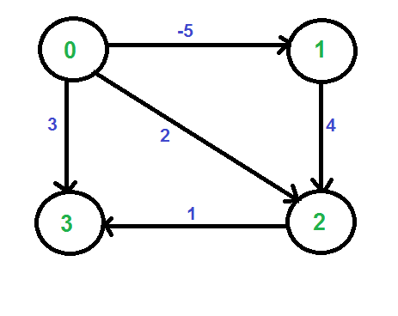
Johnson’s algorithm

Slide 20
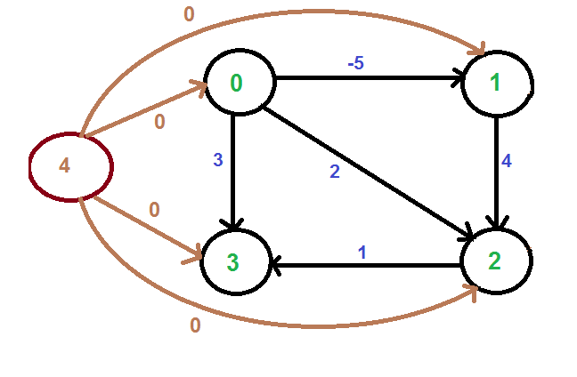
Johnson’s algorithm

Slide 21
Johnson’s algorithm
 | 0 | 1 | 2 | 3
h | 0 | -5 | -1 | 0

Slide 22
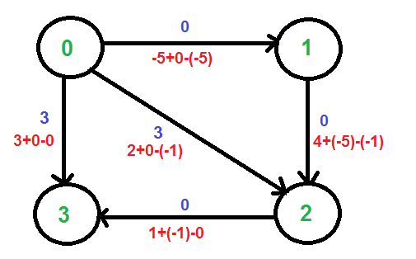
Johnson’s algorithm
 | 0 | 1 | 2 | 3
h | 0 | -5 | -1 | 0

Slide 23
Time Complexity
Time complexity of Bellman Ford is O(VE)
Time complexity of Dijkstra is O(VLogV). So for V times, this complexity is O(V²LogV).
Overall complexity becomes: O(VE+V²LogV)
This algorithm is very efficient for sparse graphs.

Slide 24
References
Introduction to Algorithm, 4th ed, Leiserson, Charles Eric, Ronald L. Rivest, Thomas H. Cormen, and Clifford Stein.
https://cp-algorithms.com/graph/all-pair-shortest-path-floyd-warshall.html
https://www.geeksforgeeks.org/floyd-warshall-algorithm-dp-16/
https://www.geeksforgeeks.org/johnsons-algorithm/

